Slide 1
Optical Flow for Vehicle Speed Measurement
Shubham Takbhate
Pulkit Mehta
Anirudh Krishnan Komaralingam

Slide 2
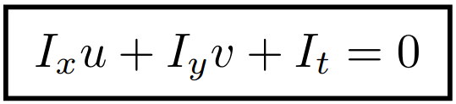
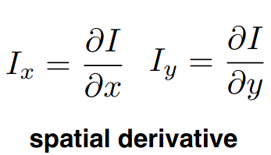
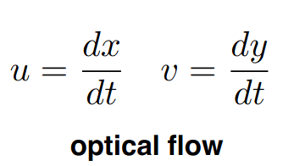
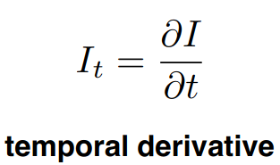
Lucas Kanade
Lucas Kanade is a framework for image matching
Assumes constant flow over small patch.
Local image flow must satisfy the flow vector:
Solve using Least squares method to compute velocity components.

Slide 3
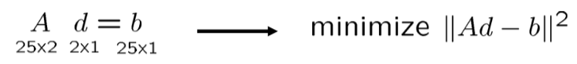
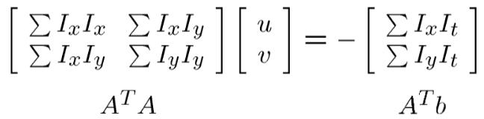
Lucas Kanade
When working with a 5x5 region we need to solve:
Works best when eigenvalues A^{T}A are large. Corners are the best features to track optical flow.

Slide 4
Image Processing Pipeline
The major components of the pipeline comprise:
Corner Detection
Adaptive Histogram Equalization
Homography and Warping
Optical Flow measurement to track feature movement
Speed Computation

Slide 5
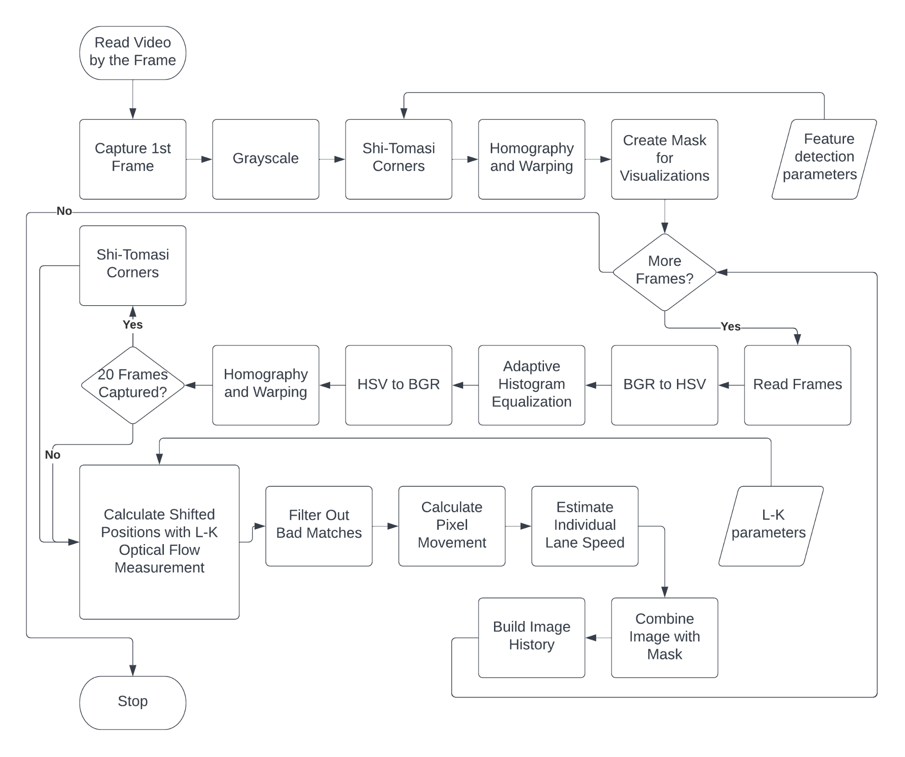

Slide 6
Speed Measurement
We use the following information to calculate speed estimates:
White dashed line road markings are assumed to 10 ft in length according to Manual on Uniform Traffic Control Devices (MUTCD) [1]
The length in pixels of the lane marking in the image can be calculated.
The Frame Rate of the video input is known (24-30 fps).
pixeldistance = distance(oldx, oldy, newx, newy)
pixelspersecond = pixeldistance * fps
meterspersecond = pixelspersecond / pixelspermeter
# Convert to km/h
kmph = round(meterspersecond * 3.6, 2)

Slide 7
Results
Three datasets with different lighting conditions and camera orientations.
Optical Flow was measured after warping the image to a bird’s eye view of the lanes.

Slide 8
Dataset Details
Stable camera looking at traffic.
Dataset 1: Daytime lighting condition. Above street level camera position
Dataset 2: Daytime lighting condition. Top view camera positions
Dataset 3: Night lighting condition. Above street level camera position
Dataset 4: Custom Daytime condition. Street level camera position

Slide 9
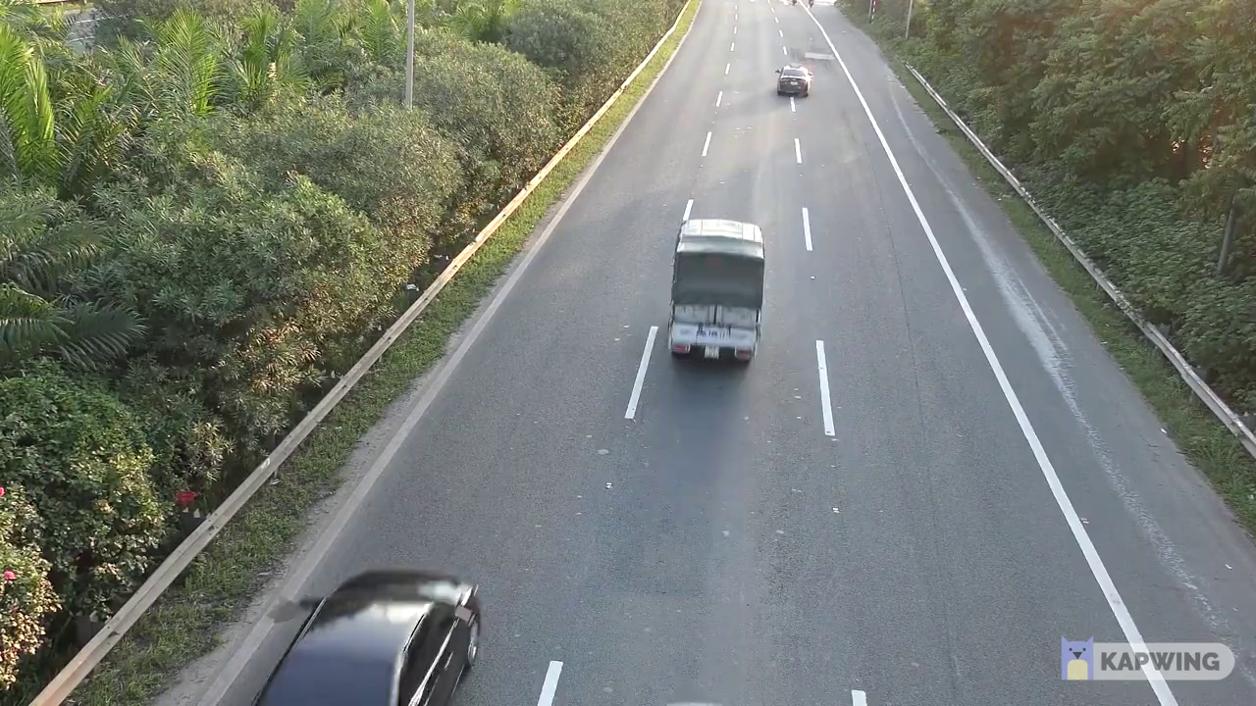
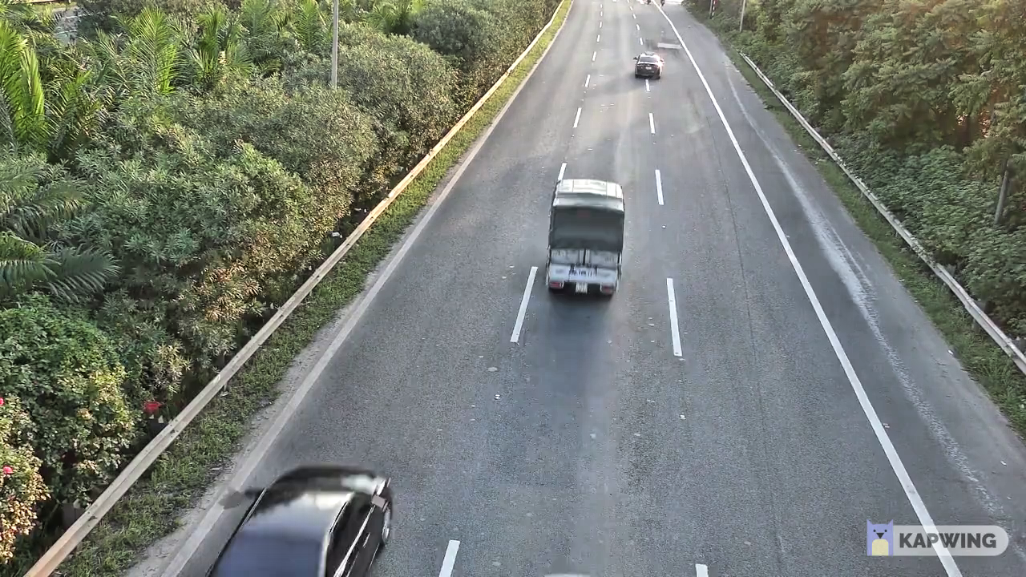
Dataset 1
Original frame
Adaptive Histogram equalized image

Slide 10
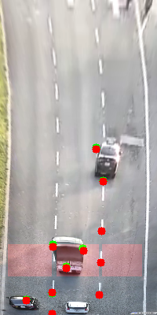
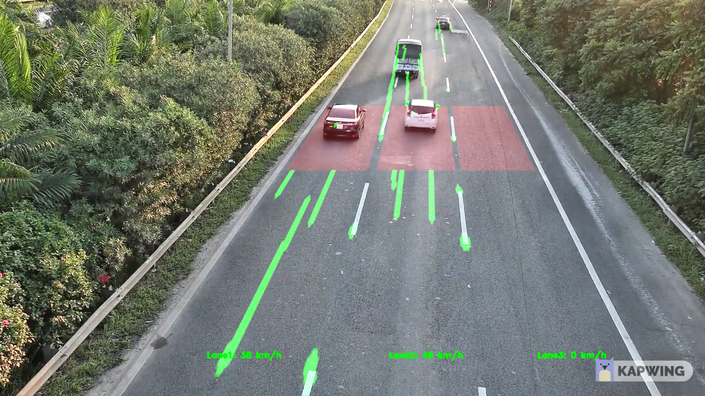
Dataset 1
Warped frame with detected corners
Tracked points in original frame

Slide 11
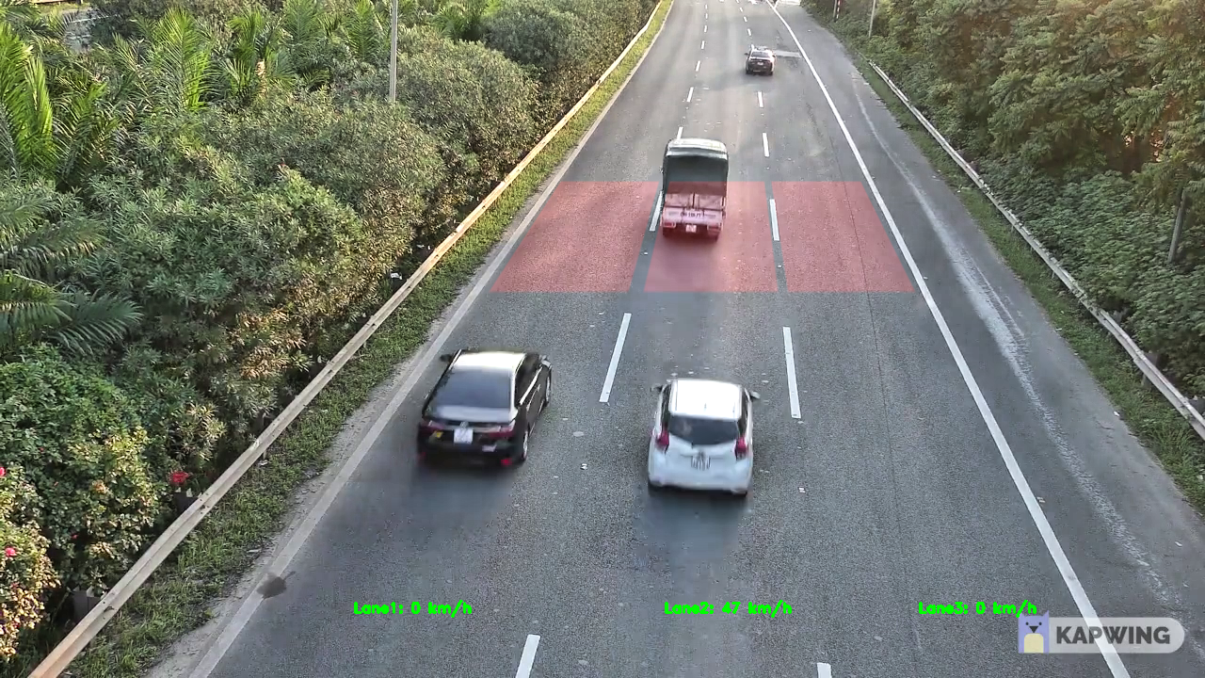
Dataset 1
Final output

Slide 12
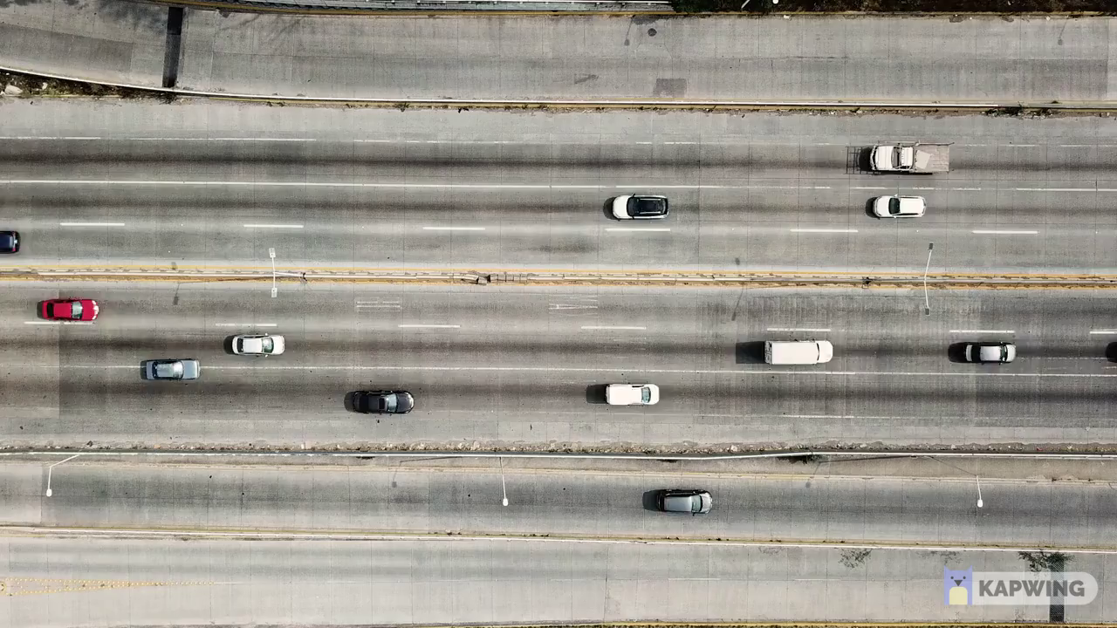
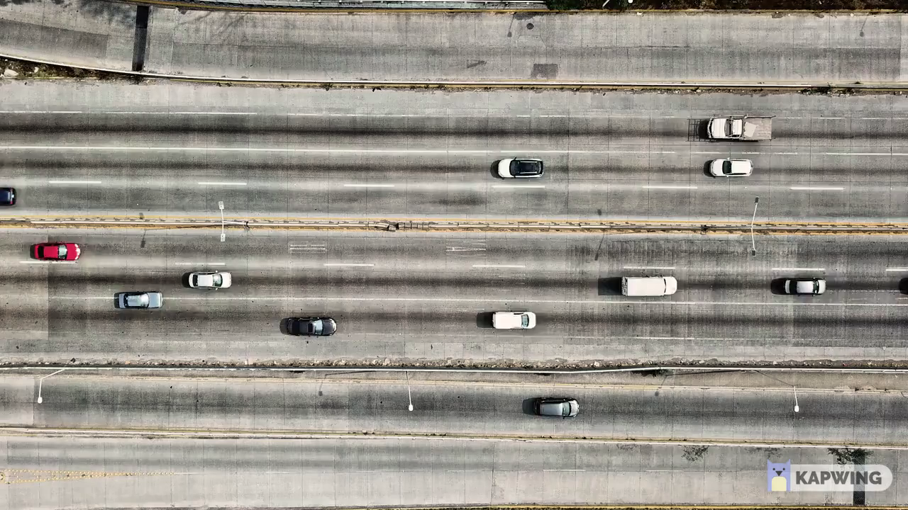
Dataset 2
Original frame
Adaptive Histogram equalized image

Slide 13
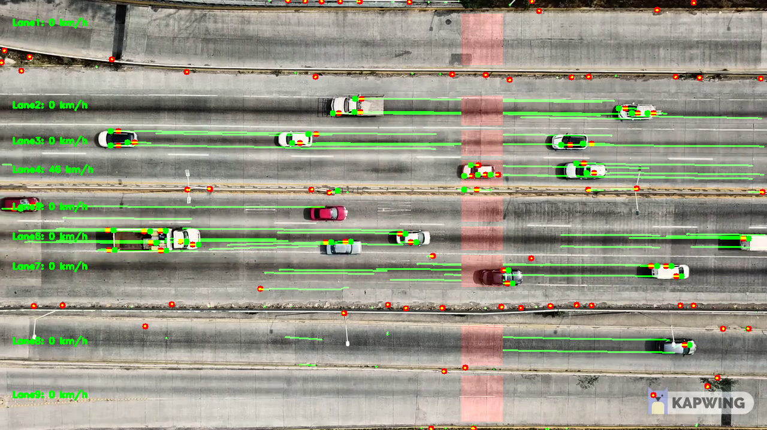
Dataset 2
Tracked points in original frame

Slide 14
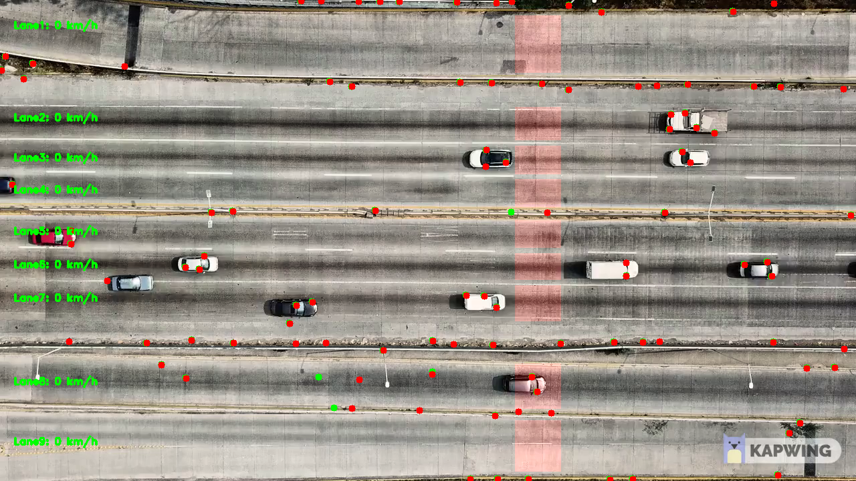
Dataset 2
Final output

Slide 15
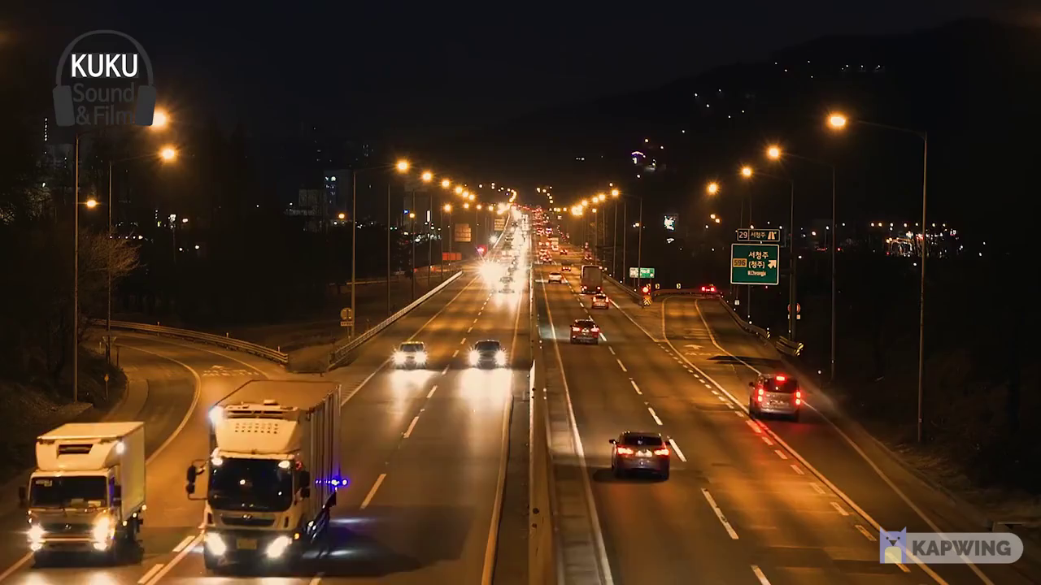
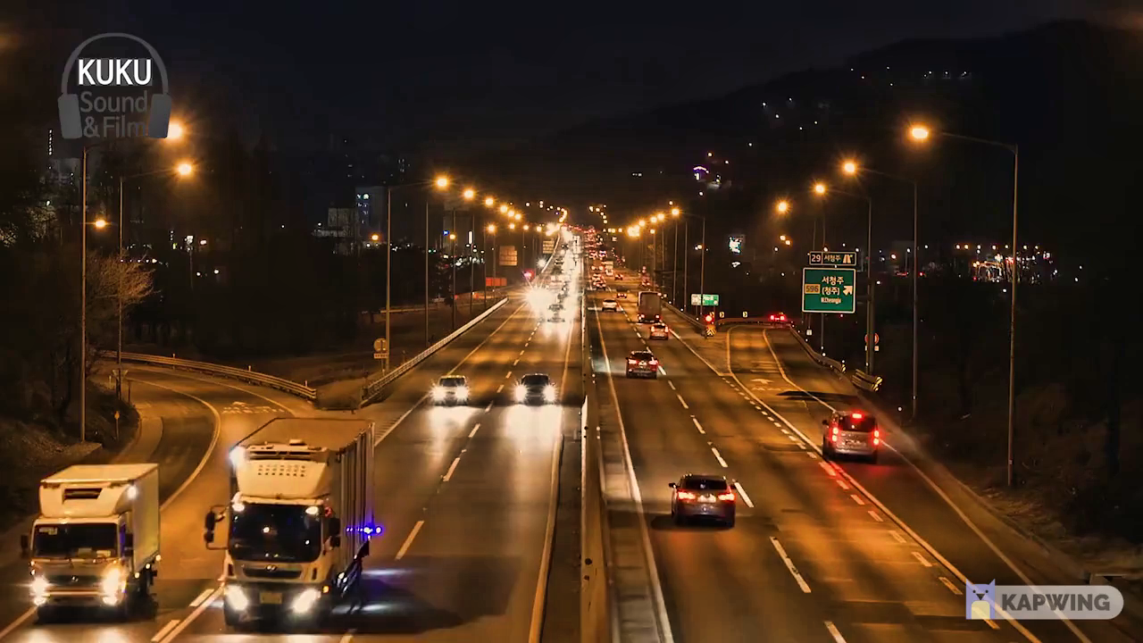
Dataset 3
Original frame
Adaptive Histogram equalized image

Slide 16
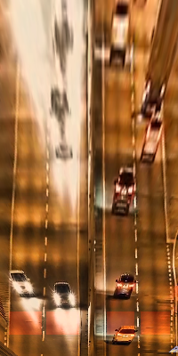
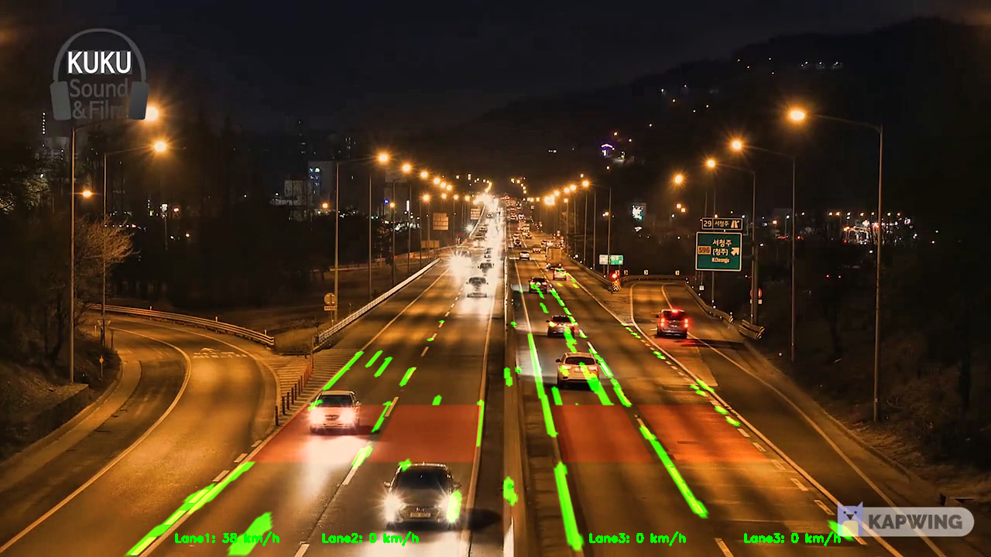
Dataset 3
Warped frame with detected corners
Tracked points in original frame

Slide 17
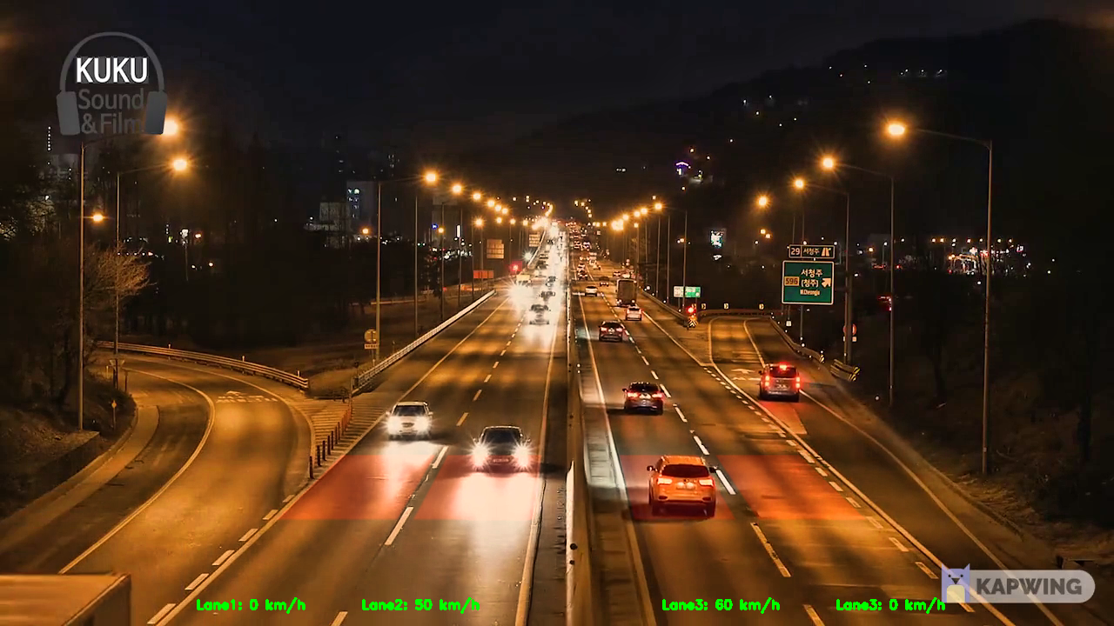
Dataset 3
Final output

Slide 18
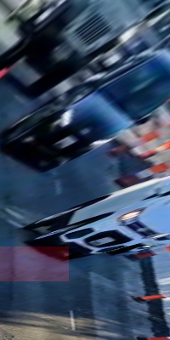
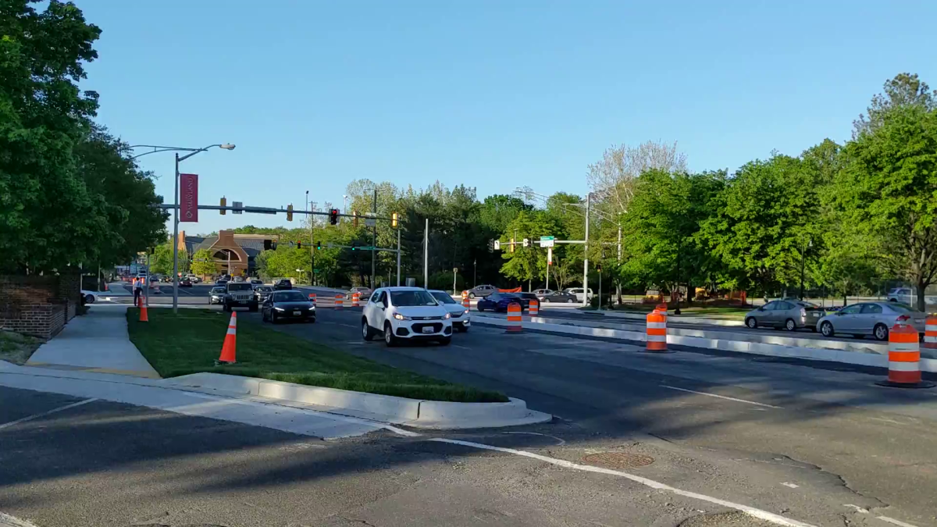
Custom Dataset
Original frame
Warped frame with detected corners

Slide 19
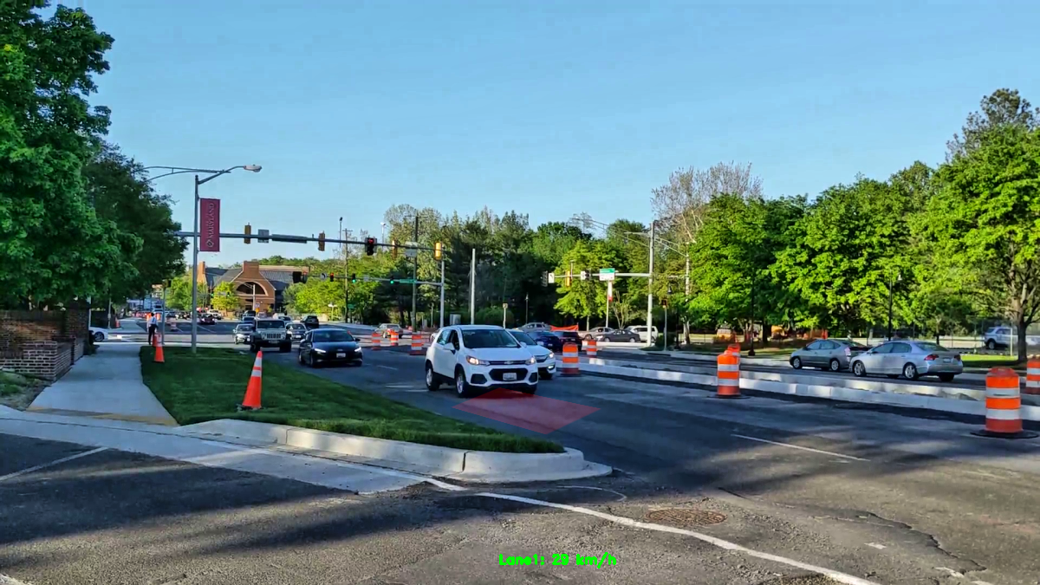
Custom Dataset
Final output

Slide 20
Limitations
It is not possible to measure the speed of of vehicles that drive out of the region to be warped
Depth estimation could not be performed if camera is oriented for side-on view of the lane.
Pipeline is dependent on the lane line information from image.

Slide 21
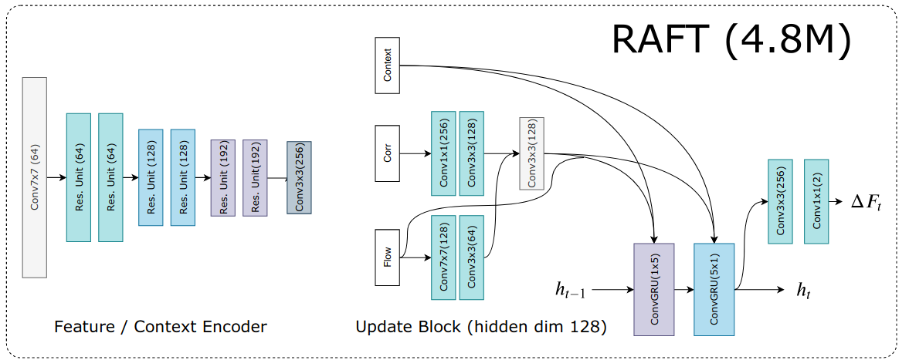
RAFT Architecture

Slide 22
RAFT
The network input consists of two consecutive frames
To extract features from these two images, we use two CNNs with shared weights
We extract feature from these two images
CNN’s architecture consists of 6 residual layers
Builds multi-scale 4D correlation volumes for all pairs of pixels(4D tensor called Correlation volumes that gives crucial information about small and large pixel displacements.)
iteratively updates a flow field through a recurrent unit that performs lookups on the correlation volumes

Slide 23
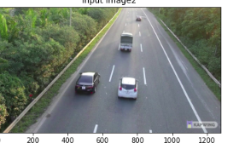
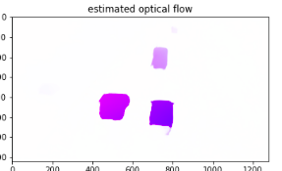
Dataset 1
Original frame
Estimated flow

Slide 24
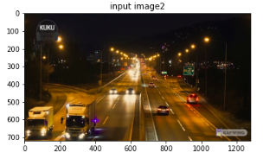
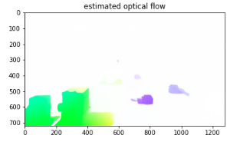
Dataset 3
Original frame
Estimated flow

Slide 25
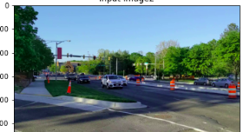
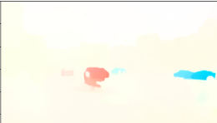
Custom Dataset
Original frame
Estimated flow

Slide 26
Conclusion
We are able to measure the speed of vehicles on a highway using Lucas-Kanade method.
The quality of the results using this method depend on the video sample and its feasibility to be warped to a top view.
We have made our speed estimation robust to lighting using Adaptive Histogram Equalization
The speed estimates from our custom dataset fall within the average speed range (18 - 25 mph) for the street.
Used to RAFT optical flow estimation to track moving objects.

Slide 27
Source Videos
Daylight: https://www.youtube.com/watch?v=wqctLW0Hb_0&t=1805s
Top View
https://www.youtube.com/watch?v=hAOF7gT7qOY
Night:
https://www.youtube.com/watch?v=xEtM1I1Afhc&t=13s

Slide 28
References
https://mutcd.fhwa.dot.gov/index.htm
[2] RAFT: Recurrent All-Pairs Field Transforms for Optical Flow by, Zachary Teed and Jia Deng

Slide 29
Joshua Harless
3101 Turner Hall, College Park, MD 20742
301.405.3384 / jharless@umd.edu

